Slide 1
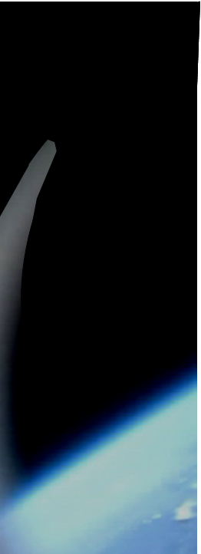





Accelerometer Calibration
RockOn! 2017
Notes:
Go to: Gyro, Pres_Temp

Slide 2
Accelerometer Calibration
Objectives
Determine calibration values for the accelerometer 3g, 16g, and 50g sensors
Notes:
Go to: Gyro, Pres_Temp

Slide 3
Accelerometer Calibration
Background
Follow the same testing procedure you used earlier to calibrate your accelerometers. You can ignore the other sensor tests.
Notes:
Go to: Gyro, Pres_Temp

Slide 4
Accelerometer Calibration
Calibration
When you have finished obtaining data, power off, remove the SD card and get data from SD by inserting into your laptop
Notes:
Go to: Gyro, Pres_Temp

Slide 5
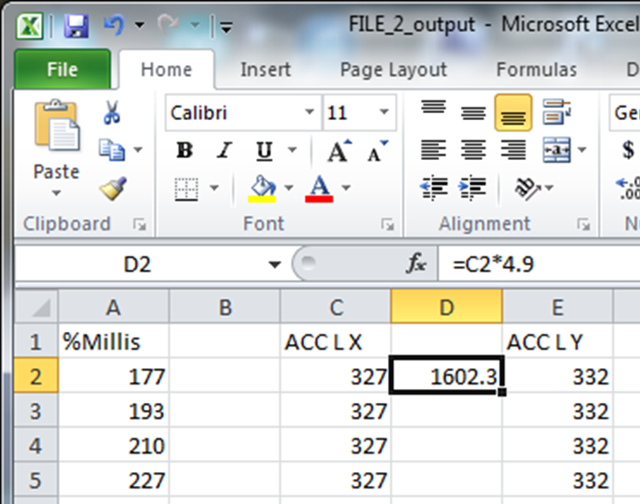
Accelerometer Calibration
Calibration
Select cell D2 and calculate C2*4.9 to get your mV readout by typing “ = C2 * 4.9” in the function box and hitting enter. Repeat this step for C3 also.
D3 “ = C3 * 4.9”
Notes:
Go to: Gyro, Pres_Temp

Slide 6
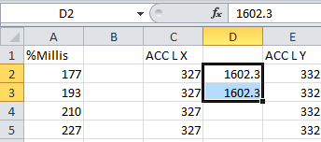
Accelerometer Calibration
Calibration
Select D3 and D4 and double click the small square in the lower right hand corner of the selected cells
Excel will now calculate the remaining rows as you did for D3 and D4
Notes:
Go to: Gyro, Pres_Temp

Slide 7
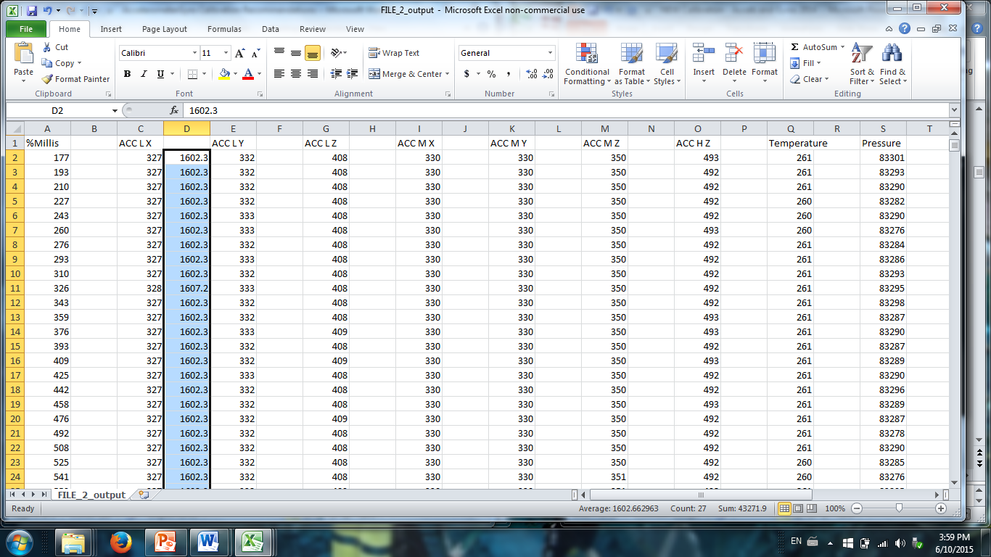
Accelerometer Calibration
Calibration
This is what your file should look like so far
Notes:
Go to: Gyro, Pres_Temp

Slide 8
Accelerometer Calibration
Calibration
Repeat this for each axis of each accelerometer so that all your columns have been converted to mV
Label each of these new columns with the same name as the column it was copied from (the name of the column just to the left)
Notes:
Go to: Gyro, Pres_Temp

Slide 9
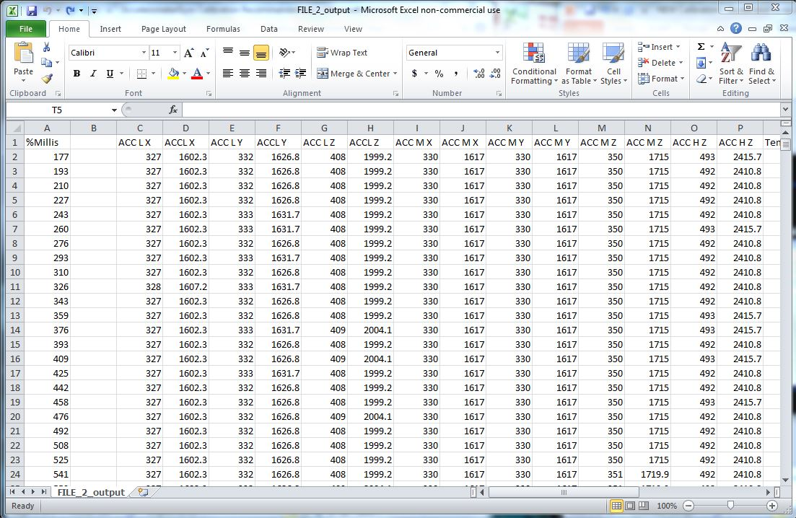
Accelerometer Calibration
Calibration
This is what your file should look like now:
Notes:
Go to: Gyro, Pres_Temp

Slide 10
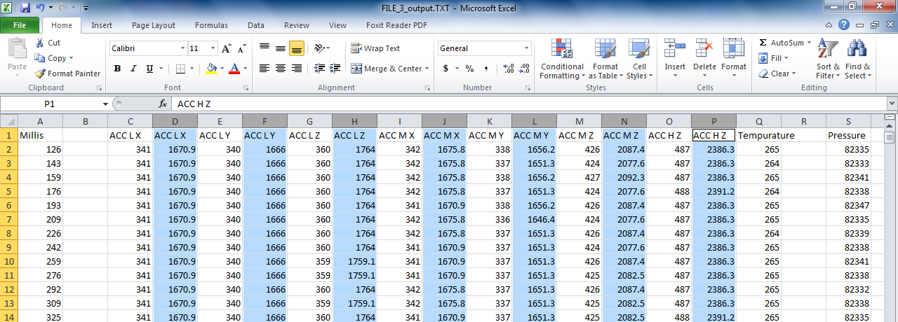
Accelerometer Calibration
Calibration
Hold down Ctrl and select the converted columns. Copy these columns and in the AccelCalibration Excel spreadsheet, select cell B1 and paste.
Notes:
Go to: Gyro, Pres_Temp

Slide 11
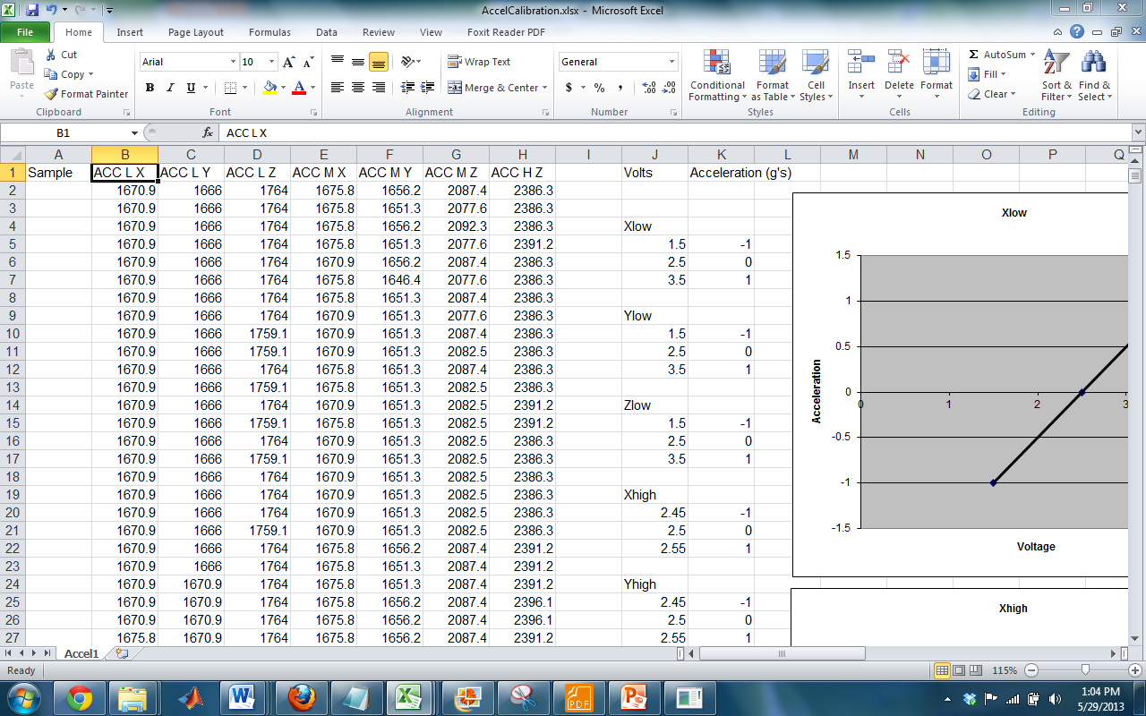
Accelerometer Calibration
Calibration
This is what AccelCalibration should look like after you paste:
Notes:
Go to: Gyro, Pres_Temp

Slide 12
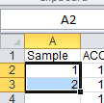
Accelerometer Calibration
Calibration
Select both of the cells containing “1” and “2” in column A and click the small square in the lower right hand corner of the selected cells. This will provide indices for all your data.
Notes:
Go to: Gyro, Pres_Temp

Slide 13
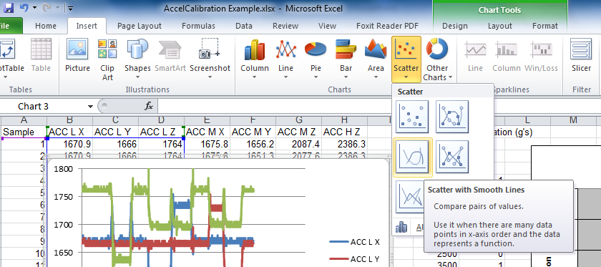
Accelerometer Calibration
Calibration
Hold down Ctrl and select columns A, B, C, and D
Click “Scatter” and “Scatter with smooth lines”. Column A will automatically be the x axis of the plot
Notes:
Go to: Gyro, Pres_Temp

Slide 14
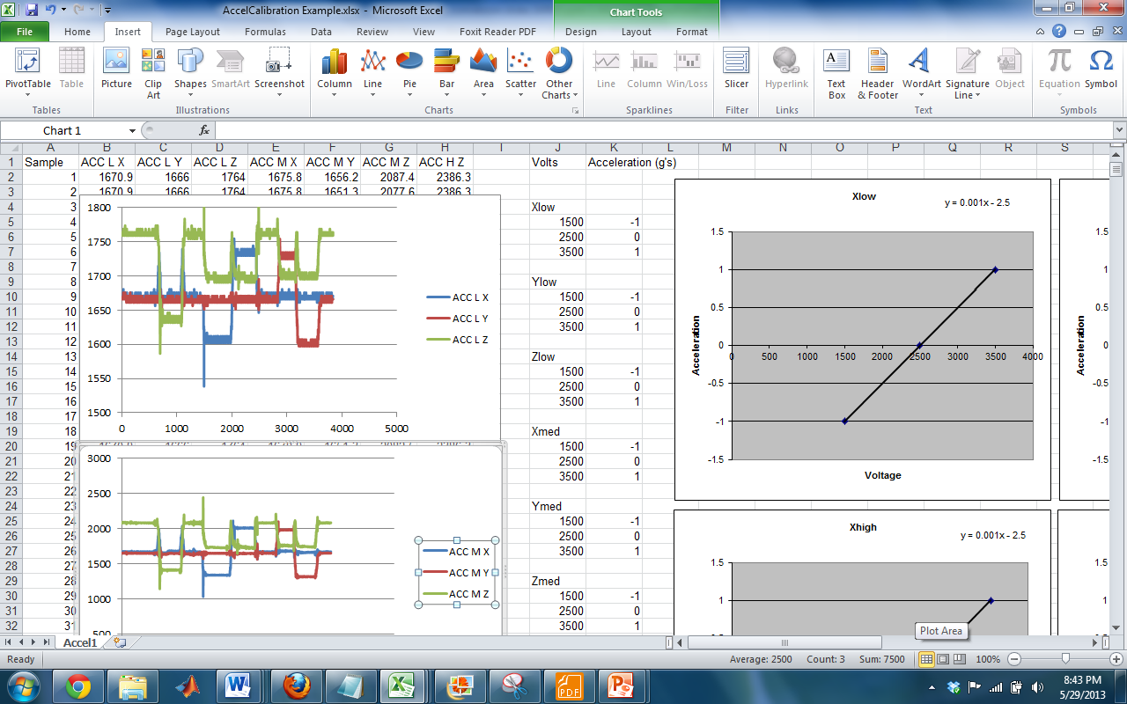
Accelerometer Calibration
The graph you just made should be similar to this one
You may want to change the y axis limits. Do this by double-clicking on the y axis numbers (boxed in the picture)

Slide 15
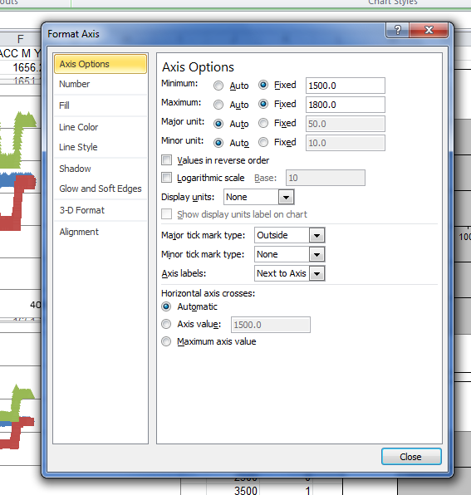
Accelerometer Calibration
In the axis limits box, change the options minimum and maximum to fixed, and enter the range you want

Slide 16
Accelerometer Calibration
This is the graph for the low range accelerometers
Notice that areas of +1g, 0g, and -1g are clearly visible on the graphs as flat areas
The Z accelerometer, on the other hand, reads about 70mV above the other two, the equivalent of more than 1g!
+1g
0g
-1g

Slide 17
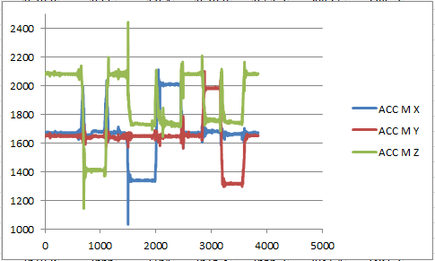
Accelerometer Calibration
- This is the graph for the medium range accelerometers
Notice that the X, Y, and Z accelerometers seem to have produced similar outputs.
On this particular graph, the three sensors produce very similar outputs, but on careful examination slight shifts are visible
- To graph, Hold down Ctrl and select columns A, E, F, and G
- Click “Scatter” and “Scatter with smooth lines”.

Slide 18
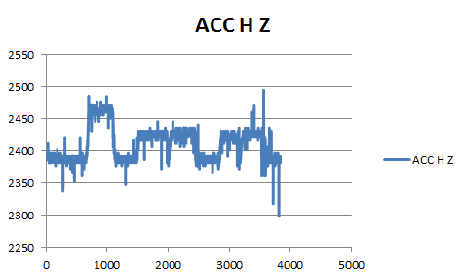
Accelerometer Calibration
This is the graph for the high z accelerometer
This output is much more messy than the other sensors. This is because it is a high-range sensor
The number of bits per g is lower since there are more g’s to measure, so the resolution is lower also
- To graph, Hold down Ctrl and select columns A and H

Slide 19
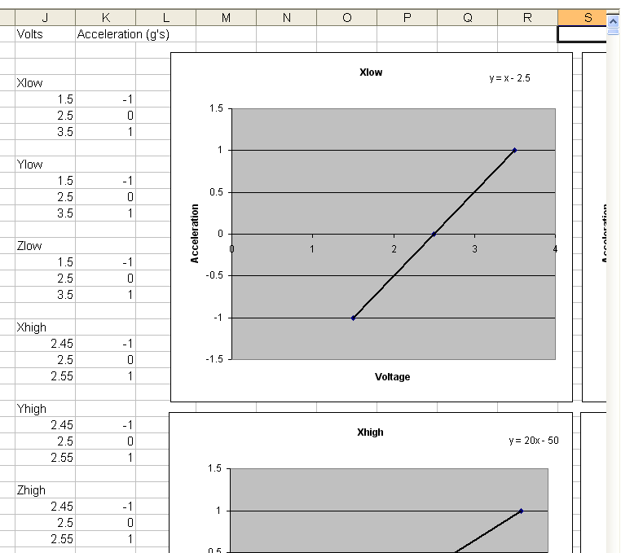
Accelerometer Calibration
- Notice the list of values in column J. At the moment, they are just dummy values, so you need to fill them in. Read the actual values off the flattest parts of the graphs by moving your mouse over them.
And
put it
here
Read value
from here
(Y Low, -1g)

Slide 20
Accelerometer Calibration
NOTE: It is difficult to determine the 0g values on the Z-Axis. So, you have to look at the Z-Axis during the X-Axis or Y-Axis -1g and 1g data test points. Or, you can take the average of the highest and lowest Z-Axis data test points during the -1g and 1g test points.
X-Axis -1g & 1g Data Test Points
Y-Axis -1g & 1g Data Test Points
Determine an approximate value
Take an Average of the maximum and minimum of the flat regions

Slide 21
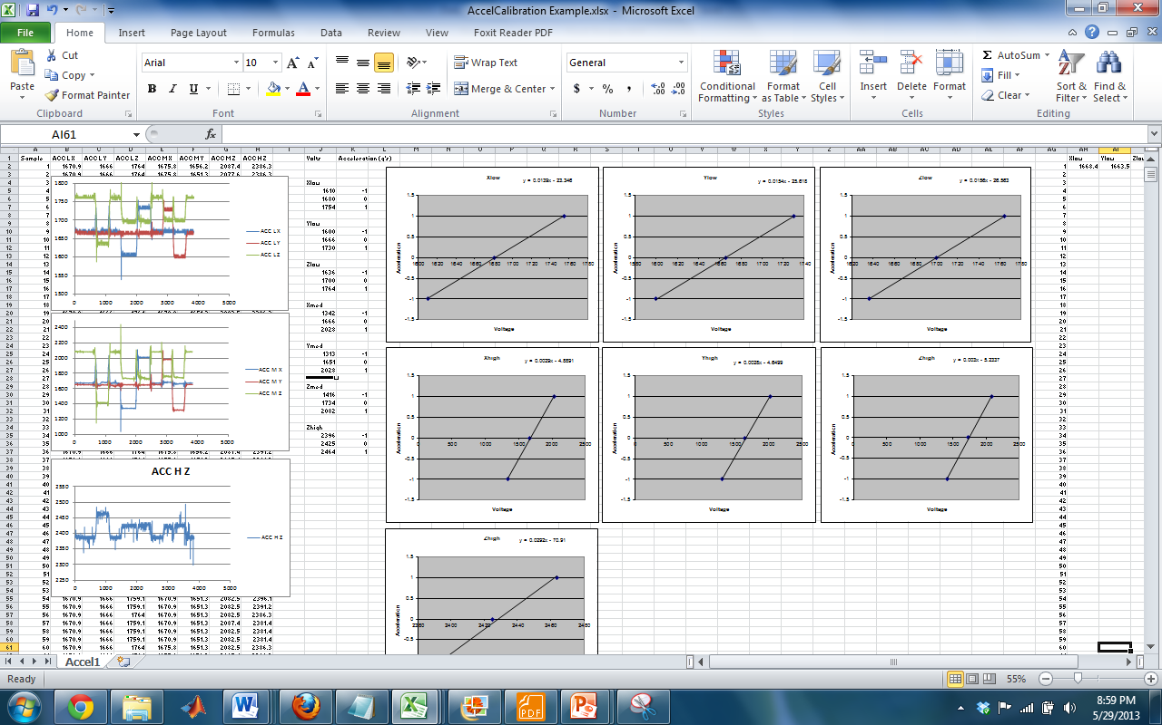
Accelerometer Calibration
The graphs and the corresponding equations will update automatically
*Note: It may be helpful to record the flat data points on a separate piece of paper to be copied into the Excel sheet.

Slide 22
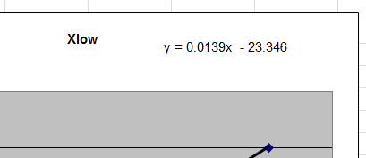
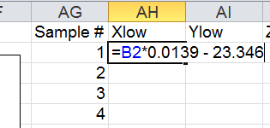
Accelerometer Calibration
Those equations can be used to convert from voltage to acceleration.
Copy column A into column AG to get the right number of indexes.
Then copy the equations from the top of each graph into the corresponding cell in row 2 of columns AH through AN by multiplying the cell by the equation. The “X” from the equation is then represented by the cell, for example, B2.
Notes:
Note that your slope value should be less than 1. If you invert it, it gives you the mV/g value (~60 for low axis accels for example)

Slide 23
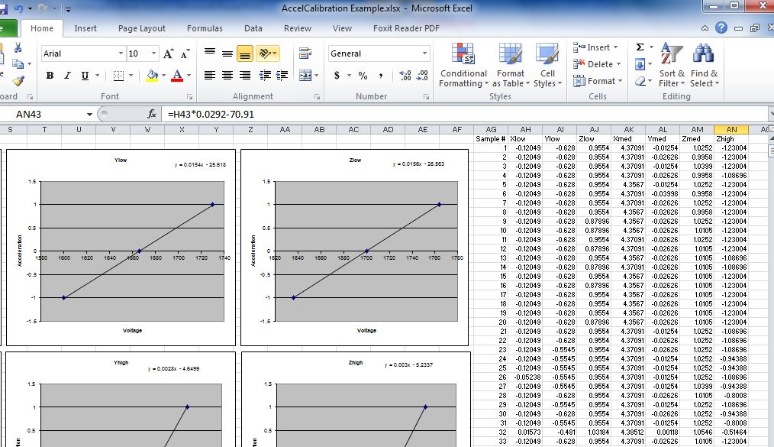
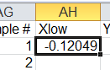
Accelerometer Calibration
Select cell AH2. As before, double click the small square in the bottom right corner of the selected cell to fill the conversion down.
Repeat for the other accelerometers.

Slide 24
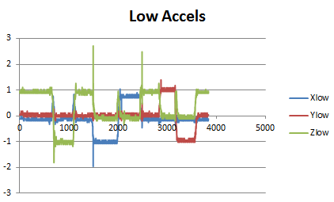
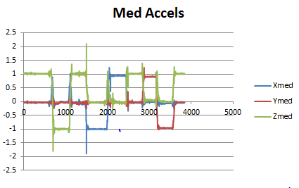
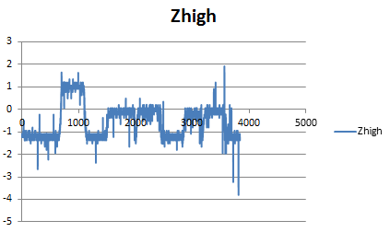
Accelerometer Calibration
Graph the converted data. You should now see all flat areas at -1g, 0g, or 1g
Repeat for X, Y, and Z Med accelerometers and the Z High accelerometer
You will use these calibration conversions with your flight data

Slide 25
Gyroscope Calibration
RockOn! 2017
Notes:
Go to: Gyro, Pres_Temp

Slide 26
Gyroscope Calibration
Background
Next we will account for the offset in the gyro values. The gyro data should be centered around 0, otherwise it will indicate higher or lower spin rates that what was truly present during flight
Notes:
Go to: Gyro, Pres_Temp

Slide 27
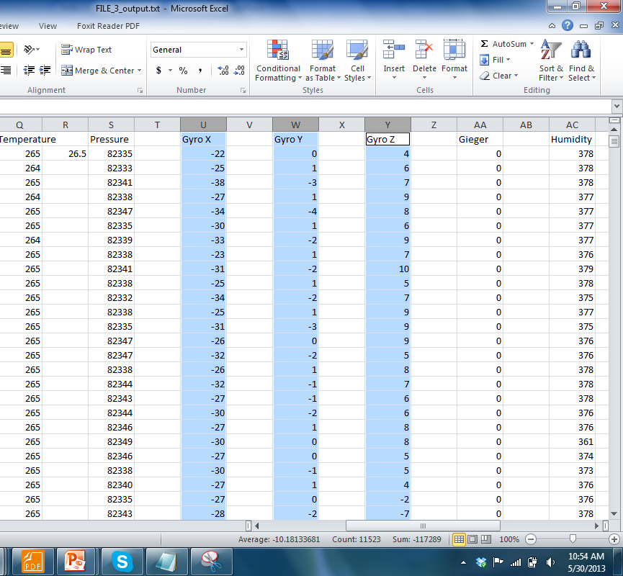
Gyroscope Calibration
Go back to the parsed data and select the three gyro data columns
Notes:
Go to: Gyro, Pres_Temp

Slide 28
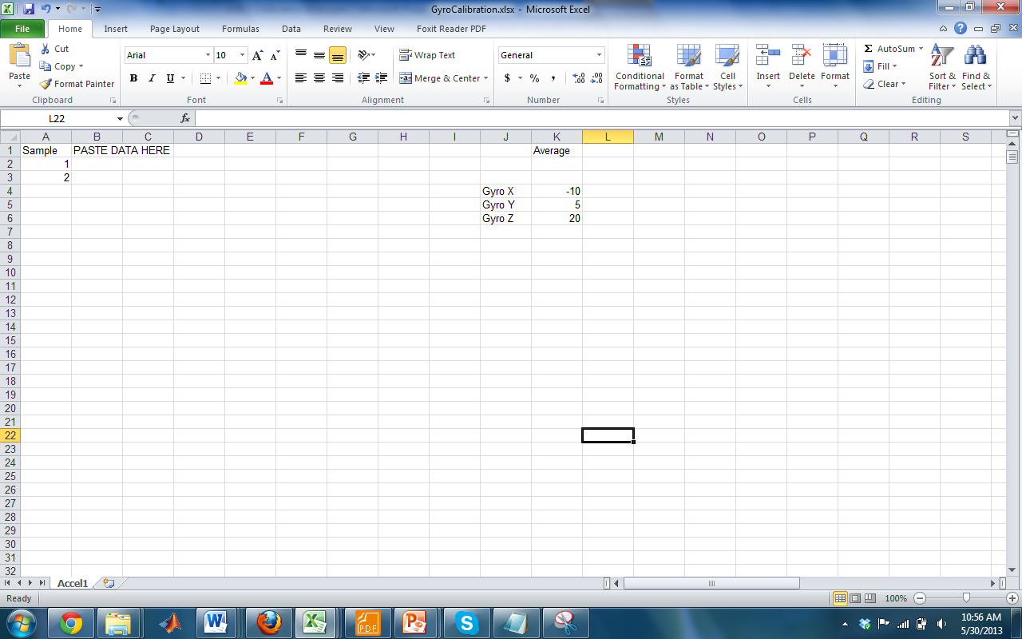
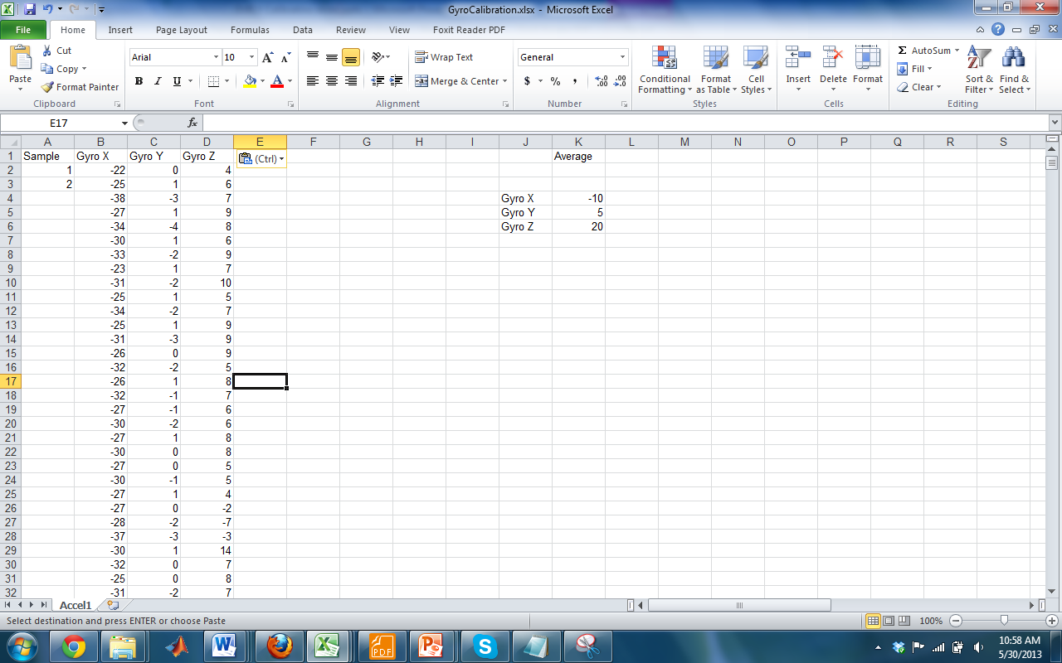
Gyroscope Calibration
Copy this data and paste it into cell B1 in the GyroCalibration excel file
Notes:
Go to: Gyro, Pres_Temp

Slide 29
Gyroscope Calibration
Calibration
Select both of the cells containing “1” and “2” in column A and click the small square in the lower right hand corner of the selected cells. This will provide indices for all your data.
Notes:
Go to: Gyro, Pres_Temp

Slide 30
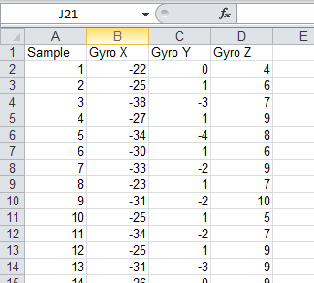
Gyroscope Calibration
Calibration
This output is already in º/s, but sometimes the baseline value is not centered around 0, as shown in the picture
Notes:
Go to: Gyro, Pres_Temp

Slide 31
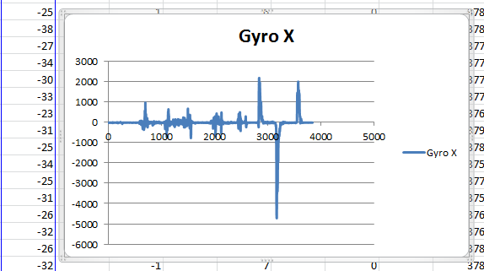
Gyroscope Calibration
Calibration
Plot one column of gyro data and look for a location where the rotation is “zero”. This will be a flat spot in the data when you were not moving your board
Good, steady
output
Notes:
Go to: Gyro, Pres_Temp

Slide 32
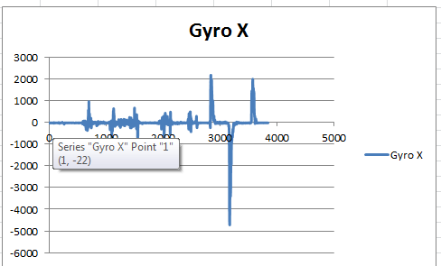
Gyroscope Calibration
Calibration
Hover your mouse near the start of this section to determine which samples you need to start at for your average.
Notes:
Go to: Gyro, Pres_Temp

Slide 33
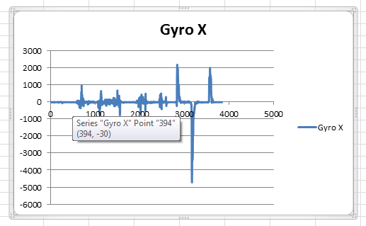
Gyroscope Calibration
Calibration
Hover your mouse near the end of this section to determine which samples you need to stop at for your average.
Notes:
Go to: Gyro, Pres_Temp

Slide 34
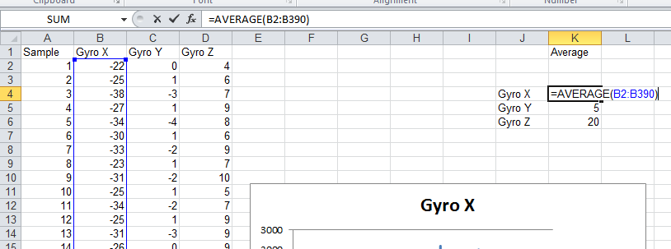
Gyroscope Calibration
Calibration
The previous picture showed that the steady range covers ~390 data points. Use the AVERAGE Function to average the data range for the gyro x data in K4
Notes:
Go to: Gyro, Pres_Temp

Slide 35
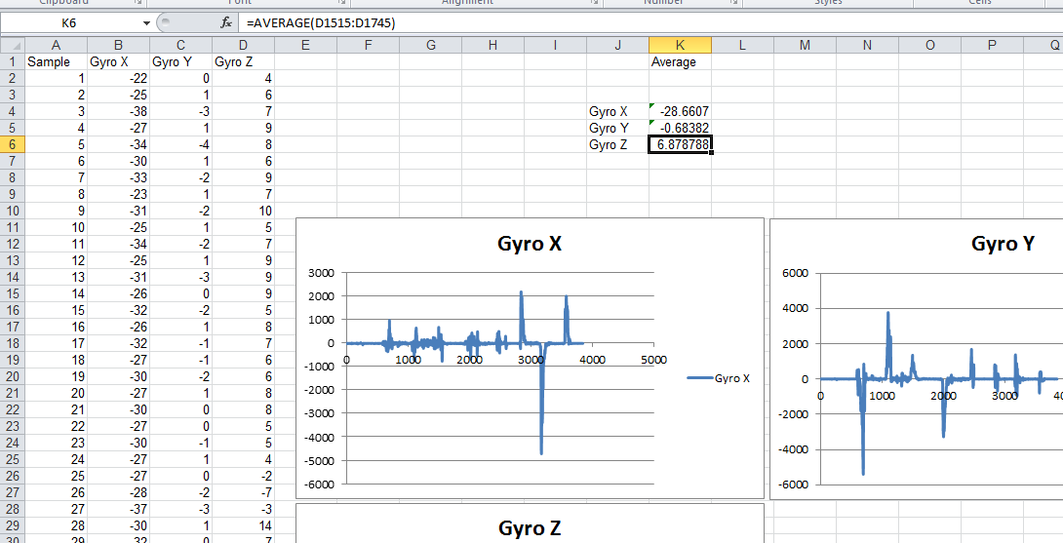
Gyroscope Calibration
Calibration
Repeat this process for Gyro Y and Gyro Z
Notes:
Go to: Gyro, Pres_Temp

Slide 36
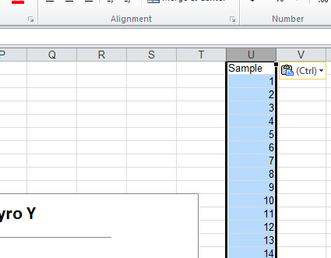
Gyroscope Calibration
Calibration
Now we need to subtract this offset from each data column. If the offset is less than +/-1, it is not necessary to subtract it out.
Copy your Sample column into column U
Notes:
Go to: Gyro, Pres_Temp

Slide 37
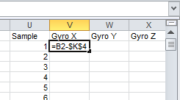
Gyroscope Calibration
Calibration
In V2, subtract the Gyro X average in K4 from the first Gyro X data value in B2. Put a “$” in front of each index for the average value ($K$4). This will hold this box constant, instead of incrementing it when we extend this to the entire data column
Notes:
Go to: Gyro, Pres_Temp

Slide 38
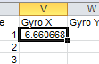
Gyroscope Calibration
Select cell V2. As before, double click the small square in the bottom right corner of the selected cell to fill the conversion down.
Repeat for the other gyroscope data sets
=B2-$K$4
=C2-$K$5
=D2-$K$6

Slide 39
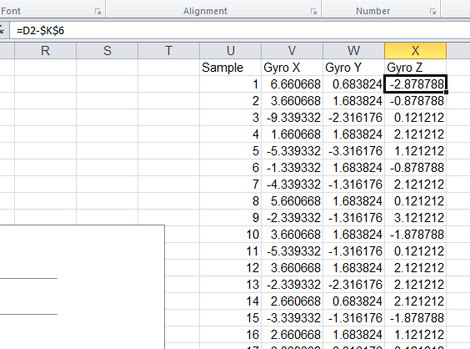
Gyroscope Calibration
Now each data column should have data centered around 0
Record the average values on your checklist for use after flight

Slide 40
END
Calibration
RockOn! 2017
Notes:
Go to: Gyro, Pres_Temp

